Slide 1
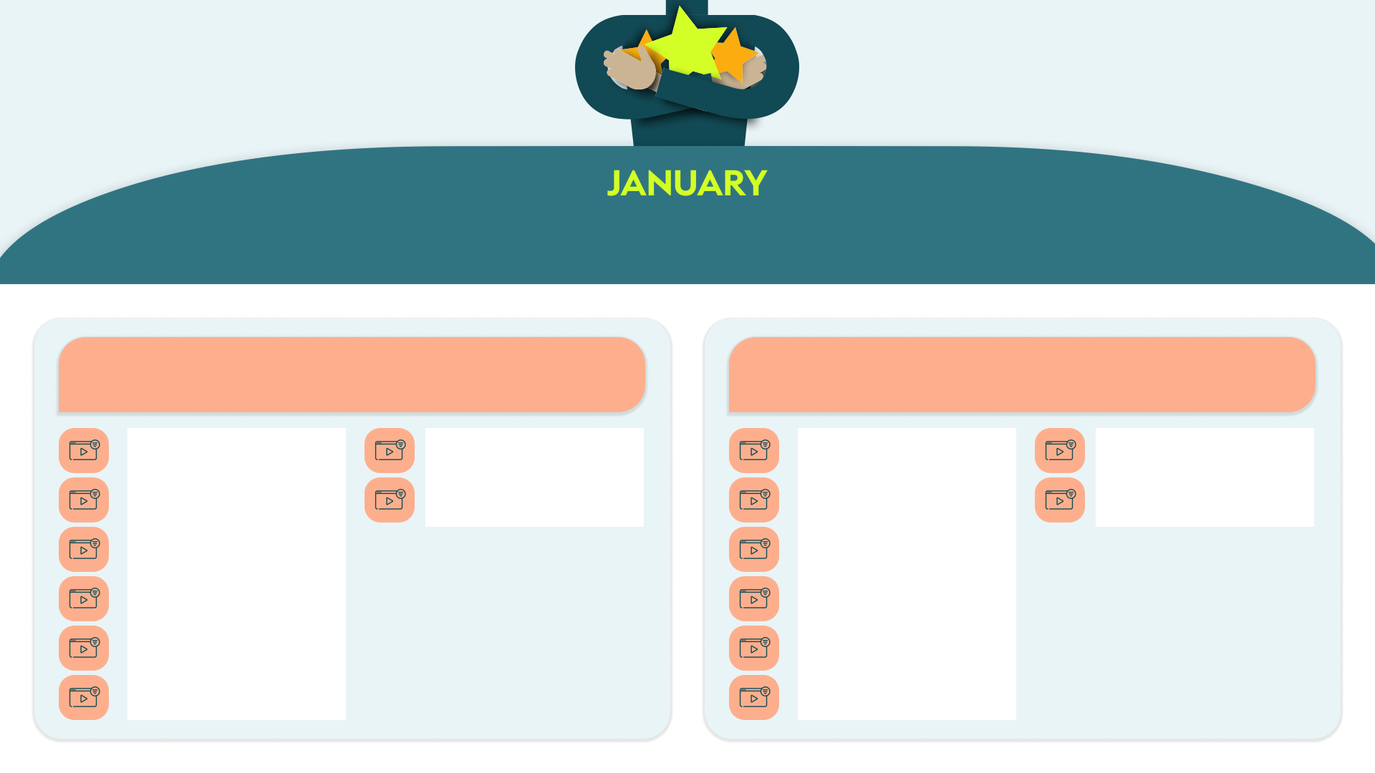
Key themes: Digital Demand Gen | Social Media Impact
Drive Demand with Digital Marketing: Proven Strategies for Growth
Maximize Marketing Impact: Effective Strategies for Social Media Success
Master The Art of Digital Marketing with Canva by Coursera (115 mins)
Accelerating Your Business’ Growth With Strategic Partnerships & Joint Ventures with Amber Spears by Entrepreneur Now …(40 mins)
Social Media (Global) by HowToo Learning (20 mins)
Social Media Strategist by Stone River eLearning (780 mins)
Digital Marketing- Fluidbook by Hemsley Fraser (120 mins)
Become An SEO expert by KnowHowDo (1800 mins)
Social selling to increase your sales exponentially by isEazy (70 mins)
How To Use Social Media For Marketing Growth by The Expert Academy (60 mins)
Introduction to Digital Marketing by Left Bank (120 mins)
Social Media Usage by Open eLMS
(45 mins)
Digital Marketing: The Basics by Maguire Training (30 mins)
Using social media for prospecting and selling by Cegos Training (15 mins)
Selling in a Digital World (CPD certified) by iAM Learning (10 mins)
Social Media for Business (CPD Certified) by iAM Learning (10 mins)
Optimising Your Website & Marketing Performance – How to Start a Business by Upskillist (30 mins)
Social selling by Skillshub (10 mins)

Slide 2
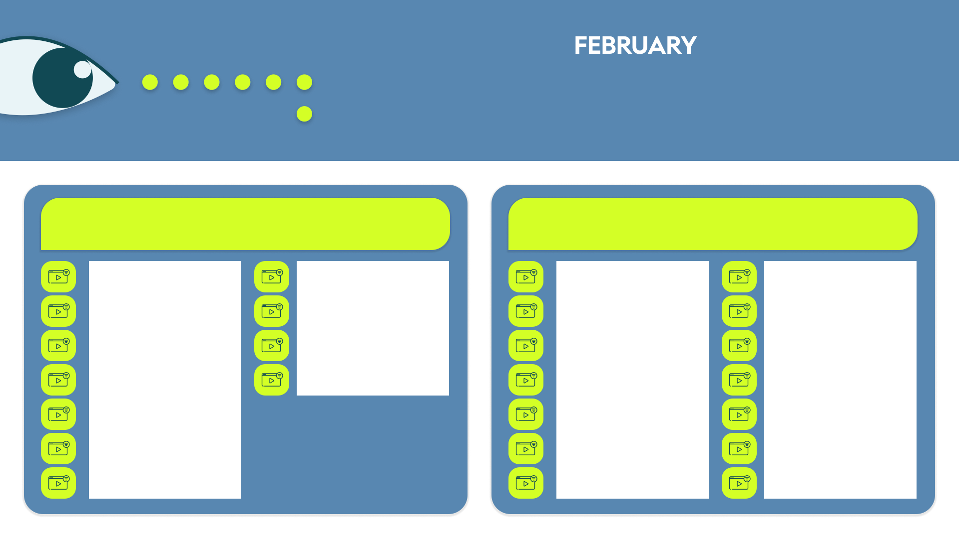
Key themes: Workplace Relationships | Challenging Conversations
Connect and Thrive: Build Strong Workplace
Relationships
Lean Into Challenging Conversations
Relationship-Building with Colleagues by ej4 (3 mins)
Introduction to Emotional Intelligence: Navigating Workplace Relationships by Compono (30 mins)
Why Having Difficult Conversations Can Be Beneficial by Skillshub (4 mins)
How To Hold A Difficult Conversation by Skillshub (4 mins)
The three pillars of interpersonal excellence by Cegos Training (15 mins)
Communicating with Emotional Intelligence Module by Access Workplace Skills (30 mins)
Challenging Conversations- Fluidbook by Hemsley Fraser (120 mins)
How To Close A Difficult Conversation by Skillshub (3 mins)
Networks and positive workplace relationships by Interaction Training
(30 mins)
Building Multicultural Relationships- Fluidbook by Hemsley Fraser (120 mins)
Challenging Conversations – Scenario Cards by Hemsley Fraser (5 mins)
So you’re a manager and need to have a difficult converstion…by Compono
(7 mins)
Building Influence by Maestro
(15 mins)
Navigating Generational Differences by EasyLlama (10 mins)
The THINK Approach to Challenging Conversations by Pearls of Wisdom
(4 mins)
Difficult conversations by Coaching Culture (20 mins)
Wait, what? – Tips to be a better listener by Mindscaling (5 mins)
Difficult Conversations and Handling Complaints by Interaction Training
(40 mins)
Nonviolent communication by Change the Work (20 mins)
Kindness: the key to building positive and lasting relationships by isEazy
(20 mins)
Difficult Conversations by The Expert Academy (25 mins)
How to Remain Cool and Collected in Challenging Conversations by SkillPath
(55 mins)
Collaborate Effectively by FutureThink (24 mins)
Preparing For a Difficult Conversation by Skillshub (3 mins)
Turning Challenging Conversations Into Successful Collabor…by Workright Ltd (20 mins)

Slide 3
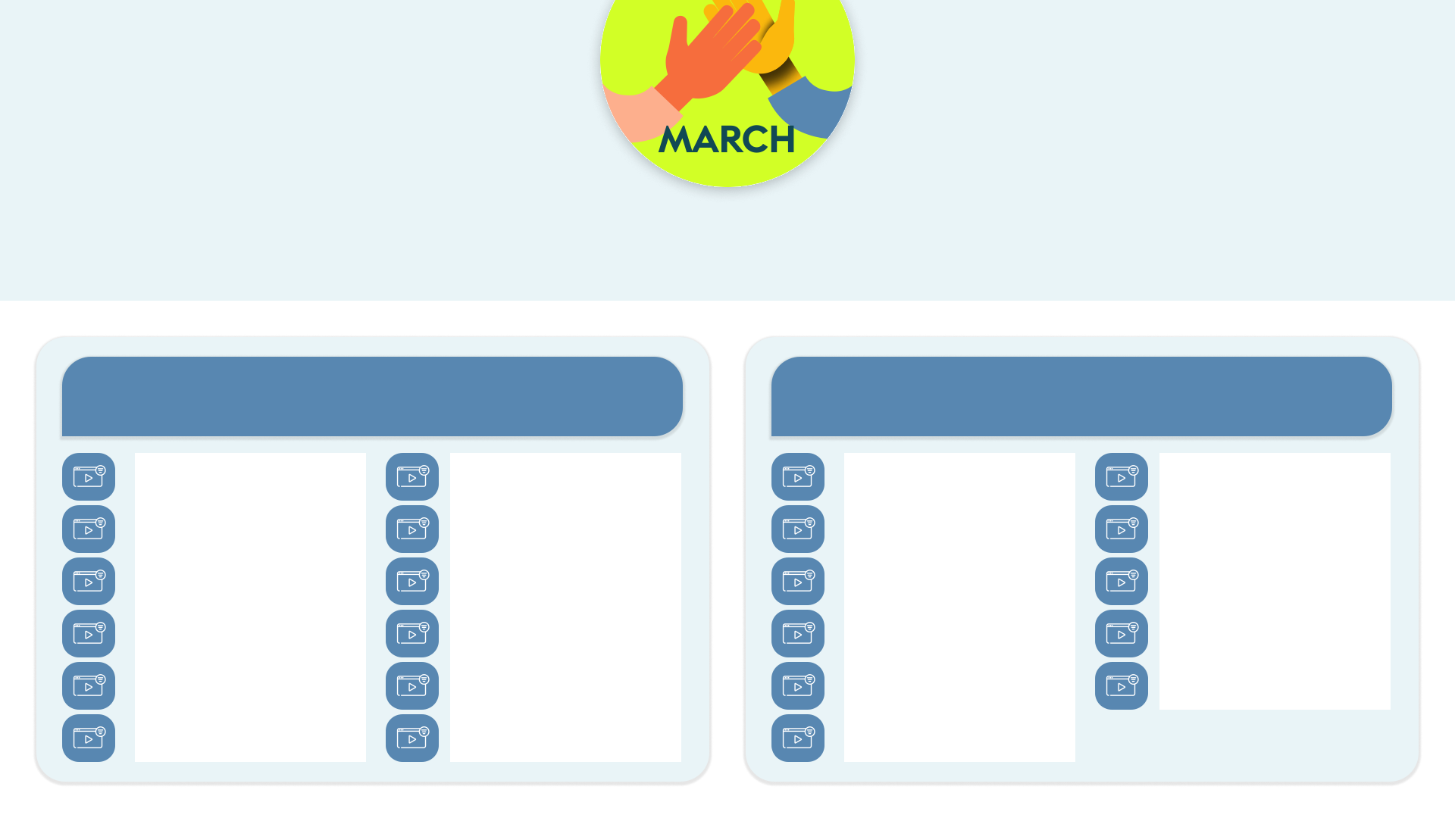
Key themes: Workplace Belonging | Diversity, Equity and Inclusion
Foster Belonging: Creating Inclusive Environments for All
Break Down Barriers: Embracing DEI
Belonging at Work – Fluidbook by Hemsley Fraser (120 mins)
LGBTQI+ Movement: For an inclusive environment by isEazy (70 mins)
Diversity Basics: Foundations by Earnit
(40 mins)
Cross-Cultural Intelligence by Symmetra
(15 mins)
BEDI Toolkit (CPD Certified) by iAM Learning (30 mins)
Using Proper Pronouns by Emtrain
(5 mins)
Unconscious Bias by Maestro
(15 mins)
Intercultural Teams—Communicating with Colleagues from Other Cultures by Pinktum (70 mins)
Psychological Safety Behaviours by Symmetra (15 mins)
Microlearning: Allyship - Calling Out & Calling In by UmbrellaHR (5 mins)
Disability Inclusion by Symmetra
(15 mins)
How to create inclusive conversations by isEazy (70 mins)
So you want to make your workplace more inclusive… by Compono
(6 mins)
Embedding Inclusion by Symmetra
(15 mins)
Understanding Intersectionality – Interactive by Seven Dimensions
(20 mins)
Neurodiversity in the Workplace - The Value of Thinking Differently by Compono (30 mins)
Disability Inclusiveness by ViaUp
(20 mins)
Cultural Awareness: How to develop your cultural awareness and sensitivity by isEazy (70 mins)
Addressing Microaggression at Work by mybreev (5 mins)
Diversity of Thought by Symmetra
(15 mins)
Diversity, Equity & Inclusion (DEI) by mybreev (12 mins)
Inclusive Leadership by Stone River eLearning (30 mins)
Recognising Privilege (CPD Certified) by iAM Learning (10 mins)

Slide 4
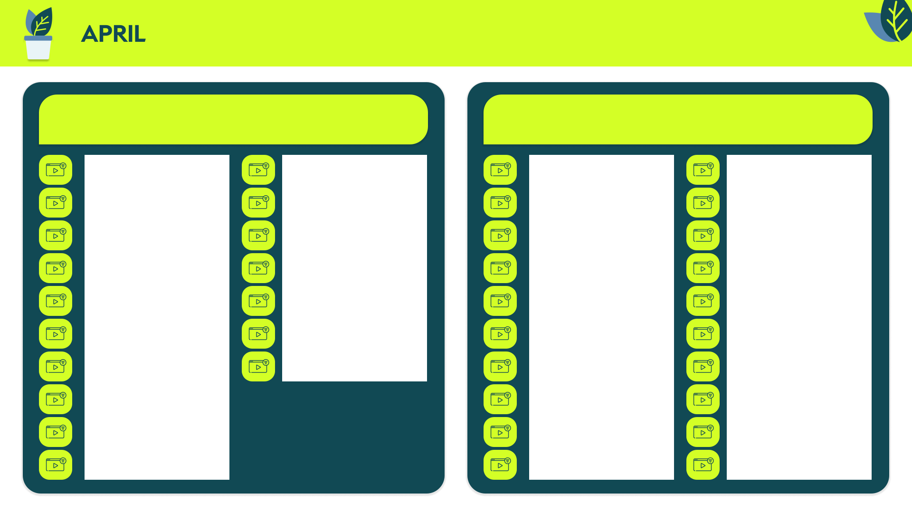
Key themes: Customer Centricity in Sales | Build Sales Acumen
Consult to Win: Master the Art of Client-Centric Selling
Build Your Sales Acumen: Foundations for Success
Selling Strategies: Consultative Selling by ej4 (5 mins)
Improve your results through consultative sales by isEazy (70 mins)
Sales Management Basics by ej4
(6 mins)
Conduct a commercial negotiation by Cegos (10 mins)
10 Minute Consultative Selling by LearningPlanet (10 mins)
The Greatest Salesman in the World by Blinkist (10 mins)
Overview of Sales Methodologies by ej4 (10 mins)
The Science of Selling by Blinkist
(21 mins)
MyStory as a Senior Salesperson: I keep my promises and consolidate the relationship… by Cegos (10 mins)
Sell Like Crazy by Blinkist (18 mins)
Sales Funnel, Process And Methodology Essentials by The Expert Academy
(54 mins)
Sales EQ by Blinkist (20 mins)
Consultant Sales by Coorpacademy
(24 mins)
From Sales Person To Trusted Advisor (10 mins)
10 Minutes Introduction to Selling by LearningPlanet (10 mins)
Effective cross-selling by isEazy
(70 mins)
Prescriptive Selling – Next Step Selling – 6 of 9 by Cultivate Advisors (21 mins)
4 Pillars of Professional Sales by Brad Thomson Coaching (480 mins)
Stages of a Sale by MaxMoLearning
(15 mins)
Elevator pitch: The ultimate technique for capturing attention by isEazy
(20 mins)
Consultative Selling skills – Why Use This Approach? By Skillshub (10 mins)
Strategic Sales – Basics of Strategic by Pinktum (60 mins)
Questioning Skills: Introduction to STeR Questions by Chart Learning Solutions (16 mins)
Retail Excellence – Features and benefits by BSI (15 mins)
Consultative Selling Reminders by Skillshub (10 mins)
Identifying Needs by Pinktum (60 mins)
Sales Effectiveness – Part 1 by Coorpacademy 16 mins)
Managing Sales Meetings by Maguire Training (30 mins)
Consultative Selling Skills – Full Course (120 mins)
Tips to Master Cold Calling by Coorpacademy (8 mins)
MyStory as a Senior Salesperson: I am a sales consultant, I help clients see new perspectives by Cegos (10 mins)
Consultative Selling (30 mins)
Successful Sales Habits by Skillshub
(10 mins)
Using social media for prospecting and selling by Cegos (15 mins)
How to detect and awaken customer’s needs (70 mins)
Prospecting by MaxMoLearning
(15 mins)
Techniques to close more sales by isEazy (70 mins)

Slide 5
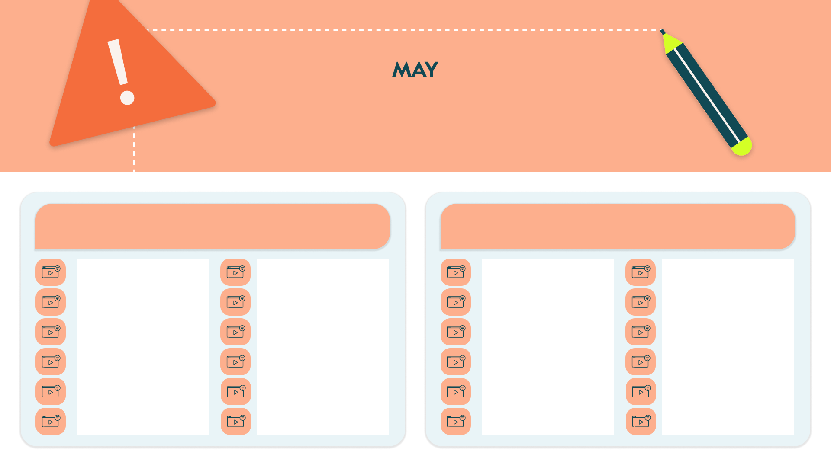
Key Themes: Presentation Skills | How to Influence
Mastering Presentation Skills: Tips for Engaging and Effective Speaking
Communicate to Influence: Strategies for Persuasion and Impact
Presentation Skills – Present like a Pro by 100% Effective (25 mins)
Presentation Skills – Fluidbook by Hemsley Fraser (120 mins)
4 Communication Skills Everyone Needs – Interactive by Seven Dimensions
(30 mins)
Building trust Through Communication by ej4 (6 mins)
The Presentation Secrets of Steve Jobs by Blinkist (16 mins)
Deliver unique, high-impact presentations by isEazy (70 mins)
Basics of Written Communication by Skilla (16 mins)
Effective Communications from Mind Tools for Business by Emerald Works
(60 mins)
Creating compelling visuals for a successful presentation by Cegos
(15 mins)
10 Minute Presentation Skills by LearningPlanet (10 mins)
Advanced Communication Skills by Skillshub (15 mins)
Effective Email Communication by Emtrain (3 mins)
Advanced Presentation Skills: Mastering the Art of Powerful Presenting Course by Compono (30 mins)
The Basic Elements of a Presentation by Pinktum (2 mins)
Persuasion And Influence by The Expert Academy (120 mins)
Non-Verbal Communication: 8 Key Insights (CPD Certified) by iAM Learning
(6 mins)
Speaking in Public: The Storytelling Approach by Coorpacademy (8 mins)
Mastering Virtual Presentations by Play4Business (30 mins)
Communication strategies… An introduction by Catalyst (60 mins)
Communication Skills Pathway by LearningPlanet (80 mins)
Presentation Skills by EasyLlama
(15 mins)
5 Essentials for Powerful Presentations by Seven Dimensions (18 mins)
Assertive Communication Toolkit by Cegos (15 mins)
Virtual Teams – Communication by Pinktum (50 mins)

Slide 6
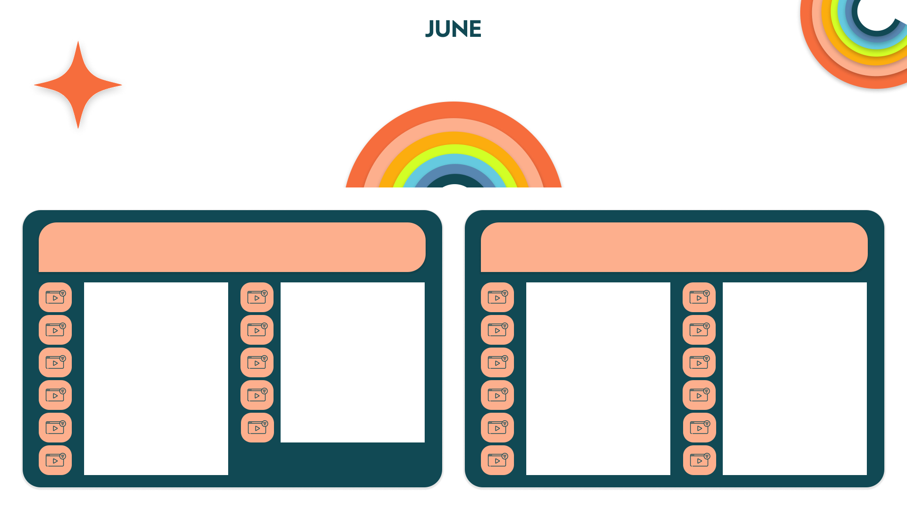
Key Themes: Talent Acquisition & Development | Employee Belonging
Attract, Hire, and Develop Top Talent
Engage, Look After, and Appreciate Employees
How Organisations Can Win the War for Talent by Emerald Works (10 mins)
Bias in the Pipeline by Symmetra (15 mins)
What is Employee Engagement – Animation by Hemsley Fraser (10 mins)
Creating a More Balanced Workplace by Mindscaling (35 mins)
Attracting Great People (CPD Certified) by iAM Learning (16 mins)
Hiring and Onboarding for Hybrid and Virtual Teams by Mindscaling (7 mins)
How to improve employee engagement by Skillshub (2 mins)
Leadership & Well-being: Beating Workplace Burnout by Compono
(30 mins)
Rockstar Recruiting by Cultivate Advisors (260 mins)
Developing Talent (CPD Certified) by iAM Learning (5 mins)
Setting Stretch Goals by Coorpacademy (8 mins)
Reward and Recognition – Infographic by Hemsley Fraser (5 mins)
Best Practices For Attracting And Developing Talent by Sarder Learning (27 mins)
Manager’s Role in Developing Talent Beginner by Intellezy (43 mins)
Leadership & Management - Importance of Motivation by Mi-Crow (5 mins)
Incentivize Employees to Innovate by FutureThink (3 mins)
Attracting and retaining talent in your business by Skilla (25 mins)
How to Best Develop Your People- Interactive by Seven Dimensions
(35 mins)
Motivate your team by Change the Work (20 mins)
10 Minute Appreciation in the Workplace by LearningPlanet (10 mins)
So you want a more inclusive hiring process by Compono (7 mins)
Virtual Teams – Communication
(50 mins)
Transformational­ Leadership—Motivating and Inspiring Employees by Pinktum (60 mins)
Improve Your Company Culture: 04. Rewards, Recognition and Creating Your Action Plan by The Expert Academy (20 mins)

Slide 7
Key Themes: Data Insights | Data Storytelling
Data Analytics: Unlock Insights to Drive Business
Success
Data-Driven Storytelling: Craft Compelling Narratives from Insights
Data Analysis Essentials by OpenLMS
(30 mins)
Design a Data Management Strategy for Microsoft Azure by Pluralsight
(97 mins)
Storytelling With Data by Coursera
(115 mins)
Organising Data in Excel: Mini Masterclass by Filtered (45 mins)
Data Analytics Made Easy by Packt
(812 mins)
Overview of Data Visualization by Coursera (87 mins)
Introduction to Data Visualisation: Seeing is Believing by Compono
(30 mins)
Top Ten Tips: Data Analysis by Filtered
(60 mins)
Statistics For Data Science by Coursera
(112 mins)
Introduction To Data Analytics Using Microsoft Power BI by Stone River eLearning (90 mins)
Data: the art and science of visualisation by Coorpacademy (24 mins)
Power BI Introduction by Open eLMS (15 mins)
Statistics and Mathematics for Data Science and Data Analytics by Packt
(682 mins)
Python for Data Analysis: Step-By-Step with Projects by Packt (655 mins)
Data Analysis Fundamentals Course by Skillshub (30 mins)
Power BI Beginner by Learnit Anytime
(96 mins)
Data Cleaning with Power BI by Packt
(680 mins)
Introduction to Data Analysis using Excel for Absolute Beginners by CloudSwyft Global Systems (14400 min)
Performing Data Definition and Manipulation in SQL by Coursera
(15 mins)
Manipulating Data in Excel: Mini Masterclass by Filtered (45 mins)

Slide 8
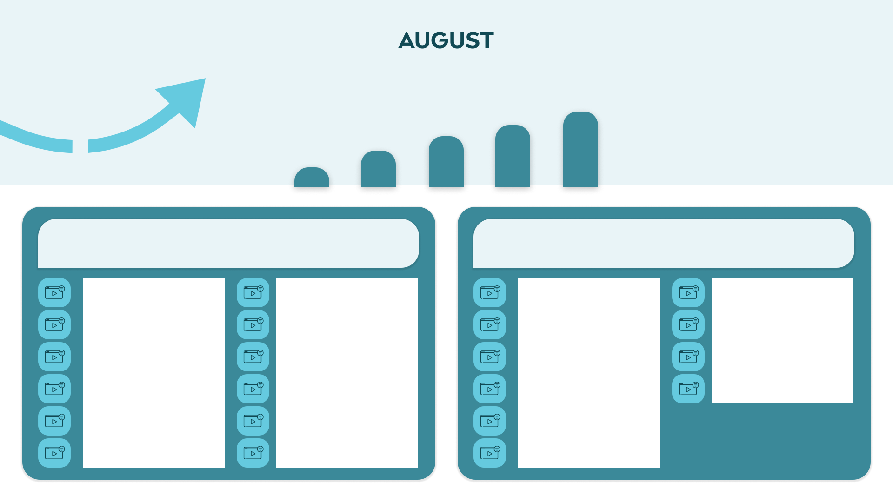
Key Themes: Financial Literacy | Financial Accounting
Financial Literacy: Empowering Non-Financial Professionals
Financial Accounting: Principles, Practices, and Reporting Essentials
Intro to Finance 02: Finance Terms by ej4 (6 mins)
Gross & Net Profit - Thrive in five by Hemsley Fraser (5 mins)
Financial Accounting – Quiz by Hemsley Fraser (10 mins)
Accounting and Financial Statement Analysis by 365 Careers (600 mins)
Get To Grips With Finance from Mind Tools for Business by Emerald Works
(60 mins)
The Definitions Of Commonly Used Financial Terms by Skillshub (10 mins)
Financial Reporting and Statements by Coorpacademy (8 mins)
FINANCIAL STATEMENT ANALYSIS MASTERCLASS FOR FINANCIAL SERVICES … by Alpha Development (22 mins)
Examining the Balance Sheet by Talent Quest (15 mins)
Understanding Profit, Cash Flow and the Balance Sheet by Maguire Training
(30 mins)
Recording Financial Information by NY Institute of Finance (60 mins)
ACCOUNTING MASTERCLASS FOR FINANCIAL SERVICES: Ebitda? by Alpha Development (20 mins)
Finance and Budgets by Coorpacademy
(24 mins)
Introduction To Accountancy & Finance by Skillshub (30 mins)
Generally Accepted Accounting Principles (GAAP) and Audits by NY Institute of Finance (60 mins)
FINANCIAL STATEMENT ANALYSIS Masterclass: Contents of an Annual Report by Alpha Development (27 mins)
Key Components of a Budget by Pearls of Wisdom (3 mins)
The profit and loss account by Skilla
(27 mins)
The Impact of Accounting Principles by NY Institute of Finance (120 mins)
The Balance Sheet Explained (CPD certified) by iAM Learning (10 mins)
Finance for Non-Financial Managers by Access Governance, Risk, and Compliance (15 mins)
Finance for Non-finance Managers - Financial Accounting – Fluidbook by Hemsley Fraser (120 mins)

Slide 9
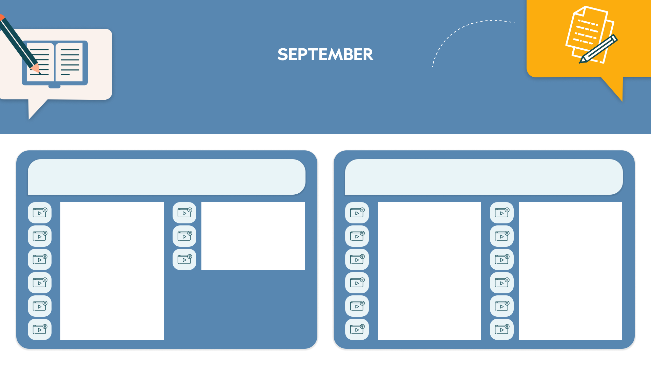
Key Themes: Project Management Techniques |
Project Management in Practice
Mastering Six Sigma and Lean: Efficient Project Management Techniques
Project Management Essentials: Skills for Planning, Execution, and Success
Introduction to Six Sigma by 100% Effective (60 mins)
Business Results for Projects by Workforge (66 mins)
What is Project Management? By Workforge (42 mins)
Beginner’s Guide to Project Management by Pluralsight (215 mins)
Lean and Six Sigma by Coorpacademy
(8 mins)
Six Sigma and the Organization [CO-OP] by Workforge (114 mins)
Fundamentals of project management by Change the Work (20 mins)
Project Management For Non-Project Managers by Skillshub (3 mins)
Six Sigma: White Belt by Human Logic
(24 mins)
Advance And Improve Your Operational Processes by The Expert Academy (45 mins)
The Project Management Course: Beginner to PROject Manager by 365 Careers (420 mins)
Accredited Agile Project Management Foundation (Scrum) by Stone River eLearning (660 mins)
Six Sigma: Yellow Belt by Human Logic
(30 mins)
Introducing Project Management from Mind Tools for Business by Emerald Works (60 mins)
Project Management: All You Need to Know by Velsoft (120 mins)
Six Sigma: Green Belt by Human Logic
(30 mins)
Project Management by Filtered
(378 mins)
Anticipating project risks - Part A by Cegos Training (15 mins)
Essentials of Six Sigma by Vector Solutions (45 mins)
Implement project management frameworks – including Agile!​ By Play4Buisiness (60 mins)
Agile Methodology for Project Management by ej4 (9 mins)

Slide 10
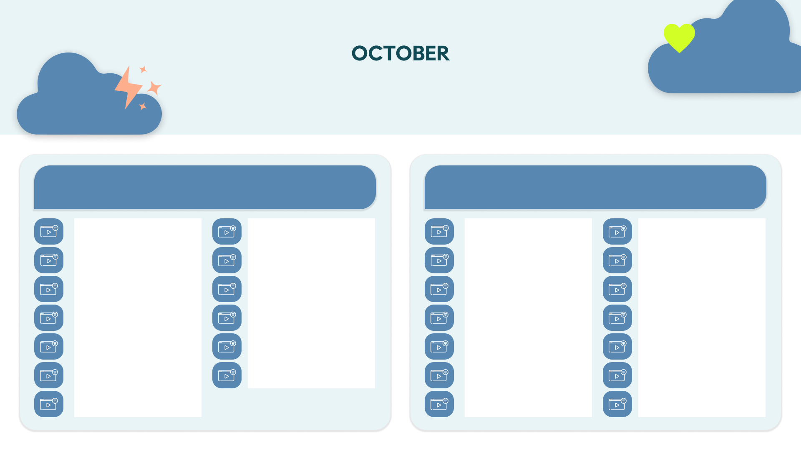
Key Themes: Customer Service | Customer Relationships
Service Excellence: Create Delightful Customer Experiences
Connect with Customers: Build Rapport and Relationships
From Pain to Gain by FutureThink
(3 mins)
Customer Centricity – Understanding, inspiring and retaining customers by Pinktum (70 mins)
1 Minute Building Rapport by LearningPlanet (1 min)
Empathy: The key to strengthening customer relationships by isEazy
(20 mins)
Consistent Sensational Service - Cutting Edge Communication Comedy Series by Seven Dimensions (7 mins)
Never Lose A Customer Again by Blinkist
(16 mins)
I Want to Deepen My Customer Relationships Without Being Annoying by Pinktum (3 mins)
Customer Retention by ej4
(7 mins)
Customer Service Excellence 10-minute Interactive Course by LearningPlanet (15 mins)
From customer hater to fan: How to exceed customer expectations by isEazy (20 mins)
Improving Customer Rapport by Talent Quest (15 mins)
Building Relationships with a Customer by Access Workplace Skills (15 mins)
10 Minutes ADVANCED Customer Service by LearningPlanet (10 mins)
Building a Successful Customer Experience - Part 1 by Coorpacademy (16 mins)
Building Rapport and Expressing Empathy in Customer Service by EasyLlama (10 mins)
Developing loyalty through customer relationships by Cegos (15 mins)
The Consultative Service Process by Interaction Training (30 mins)
Building a Successful Customer Experience - Part 2 by Coorpacademy (24 mins)
How To Build Rapport by Skillshub
(10 mins)
Build For Change by Blinkist
(12 mins)
Introduction to Customer Centricity by onehourlearning (3 mins)
Building a Successful Customer Experience - Part 3 by Coorpacademy (24 mins)
How To Build Rapport Over The Telephone by Skillshub (10 mins)
Post sales: ensuring customer satisfaction by Skilla (9 mins)
Being Customer-Centric by ej4
(6 mins)
Building Rapport by MaxMoLearning (10 mins)
Building Rapport Bundle by Chart Learning Solutions (98 mins)

Slide 11

Key Themes: Team Performance | Decision-Making and Prioritization
Unlock Excellence: Build High-Performing Teams
Leadership in Action: Master Decision-Making and Prioritization
Team Building: SMARTER Goal Setting for Team Results by Chart Learning Solutions (16 mins)
Tips For Giving And Receiving Feedback by The Expert Academy (10 mins)
The First 2 Hours by Blinkist
(15 mins)
Get Control! of Virtual Meetings and Outlook by Get Control (30 mins)
Goal Setting For Businesses And Teams by The Expert Academy (40 mins)
Thanks for the Feedback by Blinkist
(15 mins)
Analytical thinking: The key to making good decisions by isEazy (70 mins)
Time Management – Fluidbook by Hemsley Fraser (120 mins)
Successfully Structuring Team Development Pinktum (60 mins)
Creating a Feedback Culture from Mind Tools for Business by Emerald Works (60 mins)
Making Good Decisions by Pinktum
(70 mins)
Building Effective Teams – Fluidbook by Hemsley Fraser (120 mins)
Team Building: Measuring Team Performance by Chart Learning Solutions (18 mins)
Effective delegation by Me Learning
(15 mins)
Coaching for Peak Performance Beginner by Intellezy (41 mins)
Building High Performance Teams Beginner by Intellezy (34 mins)
Delegation Skills For Managers by The Expert Academy (45 mins)
Coaching – Fluidbook by Hemsley Fraser
(120 mins)
Managing High Performing Teams – Fluidbook by Hemsley Fraser (120 mins)
Effective Delegation – Fluidbook by Hemsley Fraser (120 mins)
Giving Feedback with SBI Method by Cegos (7 mins)
Urgent! By Blinkist
(23 mins)

Slide 12
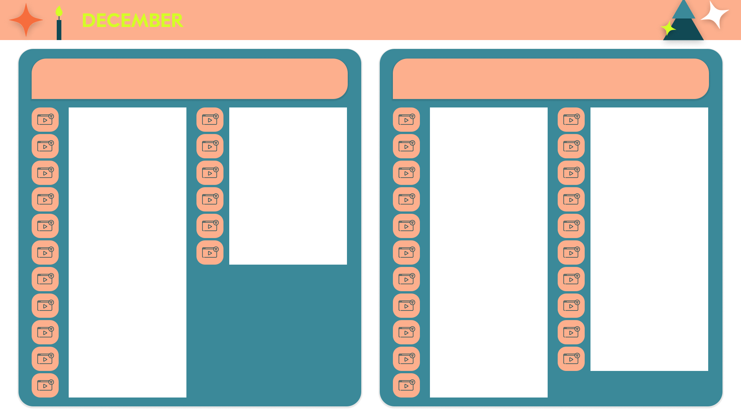
Key Themes: Business Acumen | Microsoft Office
Business Acumen: Complex Problem-Solving and Critical Thinking
Master the Microsoft Officeverse
Business Acumen by Talent Quest
(15 mins)
Complex Problem Solving – Fluidbook by Hemsley Fraser (120 mins)
Microsoft Word 365 (EN-US) by TTS Learning Architects (46 mins)
Microsoft PowerPoint 365 – Intermediate by Mi-Crow (55 mins)
Critical thinking, are you there? By Coorpacademy (8 mins)
Problem-Solving Models by Maguire Training (30 mins)
Microsoft PowerPoint 365 (EN-US) by TTS Learning Architects (41 mins)
Microsoft PowerPoint 365 – Advanced by Mi-Crow (60 mins)
Critical Thinking Series by Mindscaling (60 mins)
MyStory Embracing Change: I Solve a Complex Problem with Collective Intelligence by Cegos (10 mins)
Microsoft Excel 365 (EN-US) by TTS Learning Architects (75 mins)
Microsoft Teams – Quick Start by Sonic Performance Support (34 mins)
Critical Thinking for Effective Decision-Making by Cegos (24 mins)
10 Minute Mastering Analytical Thinking by LearningPlanet (10 mins)
Microsoft Outlook 365 (EN-US) by TTS Learning Architects (18 mins)
Brain Bites - Microsoft Teams Meetings by ej4 (34 mins)
Critical Thinking by iHASCO
(15 mins)
Analytically solving a problem by Coorpacademy (8 mins)
Mastering Excel 365 – Basics by ej4
(178 mins)
Get Started with Microsoft Teams by Coursera (93 mins)
Thinking Fast and Thinking Slow by ej4
(8 mins)
Think Again by Blinkist
(21 mins)
Mastering Excel 365 - Beginner (2022) by ej4 (128 mins)
Microsoft Outlook: The Basics by iHASCO (20 mins)
Critical thinking: think harder and you'll get it right by isEazy (70 mins)
Mastering Excel 365 – Intermediate (2022) by ej4 (212 mins)
Power BI Essentials by ej4
(85 mins)
Innovative Thinking - Thrive in five by Hemsley Fraser (5 mins)
Word 365 Beginner by Intellezy
(262 mins)
SharePoint Online – EN by ENI eLearning
(184 mins)
Creativity by Coaching Culture
(30 mins)
Word 365 Intermediate by Intellezy
(385 mins)
Getting Started in Microsoft SharePoint by Coursera (86 mins)
Creative Thinking – Fluidbook by Hemsley Fraser (120 mins)
Word 365 Advanced by Intellezy
(340 mins)
Microsoft 365 Admin Tips and Tricks by ej4 (117 mins)
6 Thinking Hats as a creativity technique by isEazy (20 mins)
Microsoft PowerPoint 365 – Basic by Mi-Crow (50 mins)

