Slide 1
Leadership Upskilling Playbook
Your out-of-the-box guide to launching a learning program for leaders in your organization.
Notes:
Discovery: you've identified upskilling managers is a business / L&D priority

Slide 2
This out-of-the-box learning program covers 5 key steps to build and launch a leadership training program
Go1 is here to partner with you every step of the way
Step 1
Identify your organization's key drivers
Step 2
Evaluate your leaders' skills
Step 3
Power your program with Go1's curated library
Step 4
Market your program to drive adoption
Step 5
Measure your program's impact
1) Understanding your business needs
2) Recommending top content
3) Evaluating your program's impact

Slide 3
Retaining and developing future leaders is what is keeping your C-suite up at night
Top CEO Concerns
Attracting & retaining top talent
Developing the next generation of leaders
Maintaining an engaged workforce
Digital transformation
Global recession
Driving new product innovation
Outperforming key competitors
Navigating uncertainty
Retraining or upskilling employees
Succeeding with emerging technologies
59
50
45
40
37
36
34
32
25
24
Percentage of CEOs who selected each challenge
DDI Global Leadership Forecast, 2023
Notes:
Retaining and Developing Future Leaders Outranks Economic and Business Concerns
In the wake of one of the most dramatic workforce reshufflings in history, CEOs are ranking talent-related challenges as the ones that keep them up at night, recognizing that people will unequivocally be the driver of their success across all other business and economic challenges.
Even as concerns about recession rise to the forefront, CEOs are deeply sensitive to the fact that their most crucial group of workers—highly skilled specialists and future leaders—may leave for a better experience at a competitor, change career paths, or even take a break from the workforce due to burnout.
Citation: 500+ CEOs in the 2023 DDI Leadership Forecast survey - https://www.ddiworld.com/global-leadership-forecast-2023/ceo-challenges

Slide 4
Identify your organization's key drivers and skill gaps
Step 1
Leadership training is often flagged as a business priority for many different reasons. Dig deep to identify the key drivers and relevant skills for your organization. Below are a few common examples.
Business problems | Business outcomes |  | Learning outcomes
Low trust in leadership | Improve company culture |  | Leading with purpose and values
Multi-generational workforce & high turnover | Reduce attrition |  | Feedback and coaching
High population of first-time managers | Improve employee engagement |  | Team building and collaboration
Step 2
Evaluate your leaders’ skills
First-time managers
Active listening
Giving & receiving feedback
Prioritization
Team onboarding
Performance management
Coaching & mentoring
Building trust
Mid-level managers
Performance management
Problem solving
Delegation
Conflict management
Team development
Career development
Resource management
Executives
Vision & strategic thinking
Innovation & creativity
Motivation & engagement
Organizational culture
Inclusive leadership
Influence & authority
Goal management
Popular skills

Slide 5
Why BSI? Interactive microlearning with beautiful visuals tailored for Australia.
Step 3
Microlearning
70+
Beg & Int
EN
AUS Based
Format
Quantity
Level
Language(s)
Power your learning program with Go1’s recommended providers
Why Mindscaling? Sleek UX with calls to action that put learning into practice.
Learning Pathways
230+
Beg & Int
EN, FR, ES
US Based
Format
Quantity
Level
Language(s)
Why Cegos? Fully localized content making their content more culturally relevant for a global workforce.
Designed to build leaders at all levels
Microlearning
1100+
Beg & Int
EN, DE, JA+
FR Based
Format
Quantity
Level
Language(s)
200⁺
Leadership topics
50⁺
Playlists
Why Talent Quest? Consistent, high-quality, interactive, WCAG compliant and offer SHRM and HRCI credits.
Video
320+
Beg & Int
EN
US Based
Format
Quantity
Level
Language(s)
120⁺
Leadership content providers
15⁺
Languages
Why The Expert Academy? Courses are interactive, led by field experts, and require a passing score.
Video
95+
Beg & Int
EN
UK Based
Format
Quantity
Level
Language(s)
Notes:
For advanced leadership content, we recommend you evaluate the needed skills of your senior leaders (e.g., adaptive leadership, strategic thinking and visionary leadership, change management), and find courses on those topics within the Go1 Premium library. Go1 does offer more advanced content from a handful of content providers, but learning plans should always be tailored to the skills individuals are looking to develop.

Slide 6
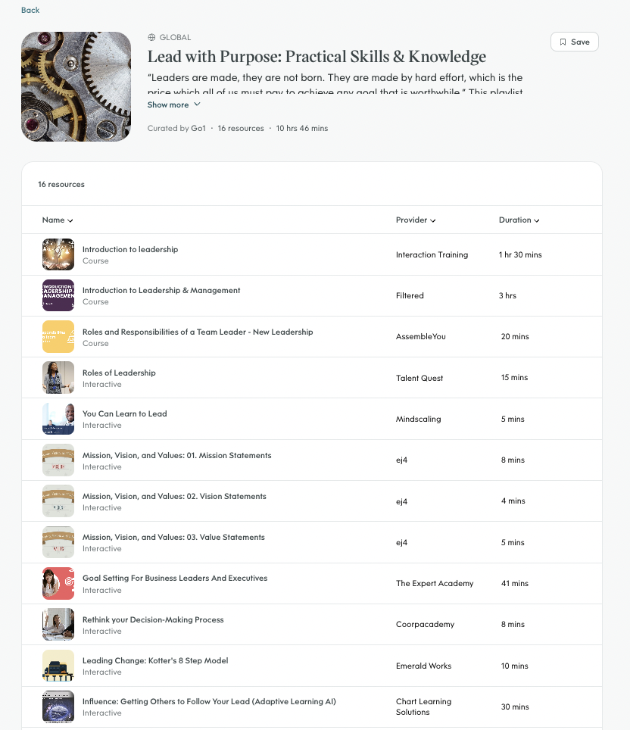
Quickly engage learners with ready-to-use learning playlists
Step 3
Recommended playlists
First-time management
Get Started in Leadership: Tips for New Leaders & Managers
Leadership: Tips for New Leaders & Managers
Get Results Through Others: Intro to Leadership & Management
Setting direction ​and vision
Lead with Purpose: Strategy & Innovation ​
Lead from the Top: Build Executive Presence & Impact ​
Leading Beyond Your Team: Influencing Others ​
Team management ​
Lead with Purpose: Practical Skills & Knowledge ​
Lead Remote Workers: Promising Practices for Remote & Hybrid Environments ​
Measure Success: Performance Appraisals & Management ​
Do the Right Thing: Corporate Social Responsibility ​
Thrive Through Change: Change Management Essentials ​
Grow Together: Make the Most of Mentorship ​
Teamwork Makes the Dream Work: How to Build and Manage Better Teams ​
…and more!
*Learning playlists are constantly evolving as new skills and courses become available. Please note that playlists are curated for global audiences and showcase a variety of courses. They are not meant to be used as sequential learning paths.
Notes:
We curate content into playlists on today's most in-demand skills that you can plug into your learning programs.
Our approach also enables learning playlists that bring together the best content across providers to deliver tailored pathways for high-priority skill development. Our Content Curation Specialists are leveraging Go1’s consumption data to recommend critical pathways, with more than 200+ already available – or you can create your own.
[NOTE TO AE] Tread carefully here – if they are accessing through a partner platform, this process isn’t as seamless as it could be. They’d have to discover playlists on Go1, and then search for the courses and put them in their own playlist through their partner admin portal.

Slide 7
Market your program to drive adoption
Step 4
More ideas for boosting engagement!
Driving awareness and engagement is key to creating a successful development program.
Below is an example of a marketing campaign to kickstart your learning program and bring it to life.
Quarterly Leadership Spotlight Highlight your organization’s favorite course, content provider, or topic each month, or spotlight an employee to celebrate the group’s learning accomplishments.
Skill building hackathon Select 1–3 skills that will benefit the entire workforce and provide real-world challenges for groups to work on. Have teams work together to share skills and knowledge.
1
2
3
4
Select your favorite Leadership Content Providers, Playlists, and Courses from Go1
Use this resource or the vast Go1 library to explore recommended providers and playlists. From there, create a Learning Plan or Calendar to deploy to leaders at different levels. This can include microlearning courses to help busy leaders stay connected.
Send learners kickoff comms to create excitement
Create an internal microsite for your Quarterly Learning Spotlight that provides an overview of the plan. Include details about why the providers were selected and what skills learners will gain.
Send a launch email introducing the program and the value!
Send a monthly update email that highlights engaged individuals
After 2 weeks, begin evaluating course completion. Send a monthly email update to participants to spotlight engaged employees and their thoughts about the program. Colleague endorsements go a long way!
Celebrate!
Wrap up the program with a positive celebratory email. Highlight the most popular courses and include quotes from champions of the program.
Learning challenges and prizes Create short learning challenges and provide small prizes (gift cards, 30 mins with the CEO, free book) to incentivize employees. This could be based on the organization’s goals, values, or specific skills.

Slide 8
Measure your program's impact
Step 5
Measuring the impact of your learning program will help you identify areas where the program excels and where it needs improvement, ensuring its effectiveness. Below are example metrics you might consider measuring before and after your learning program launches.
Employer brand
Employee turnover
Employee engagement
56%
3.5%
18%
Brand satisfaction
Turnover rate
Actively disengaged
Factors such as a sense of purpose, innovation opportunities, psychological safety, and perceptions of leaders and fairness create a great workplace culture.
Assess attrition rates 1 year after implementing your program to see if improved leadership skills made it more likely for employees to stay in their roles.
Evaluate employee engagement through your recurring employee engagement survey. Find out if employees rate the company culture higher and participate more in their daily work.
Great Place to Work
US Bureau of Labor Statistics in 2023
Gallup State of the Global Workforce: 2023 Report

Slide 9
Explore how Hays partnered with Go1 to upskill their leaders
Shenlee Walker
Director L&D/ Internal Recruitment
Hays is a UK-based staffing firm with 10,000+ employees.
Step 1
Step 2
Step 3
Step 4
Step 5
Key Drivers
Hays didn’t have a consistent way to measure the skill level of each leader, so they decided to create a standardized skill competency framework.
The key learning outcome Hays aimed to achieve was fostering 70% utilization of Go1, month over month. That's quite the feat!
Evaluating Skills
Hays determined the following leadership skills were required:
Emerging Leaders Program:
Effective coaching
Performance-based accountability conversations
Inclusive culture in a hybrid world
They also identified skills for a Management Development Program!
Go1’s Content
Hays partnered with Go1 to curate a list of relevant courses from the Go1 Premium Library from top providers like:
Marketing
Hays launched a monthly newsletter to boost engagement with Go1.
Shen's newsletter best practices:
Develop a brand for the learning campaign
Link directly to Go1
Be consistent
Include post-learning surveys to collect feedback
Impact
Hays measured Go1’s utilization by automatically tracking:
Top users
Utilization in the last 30 days
Utilization in the last 60 days
If employees don’t meet the above requirements, their managers follow up with them to increase engagement.
Confidential - Do Not Distribute
Notes:
Customer story

