Slide 1
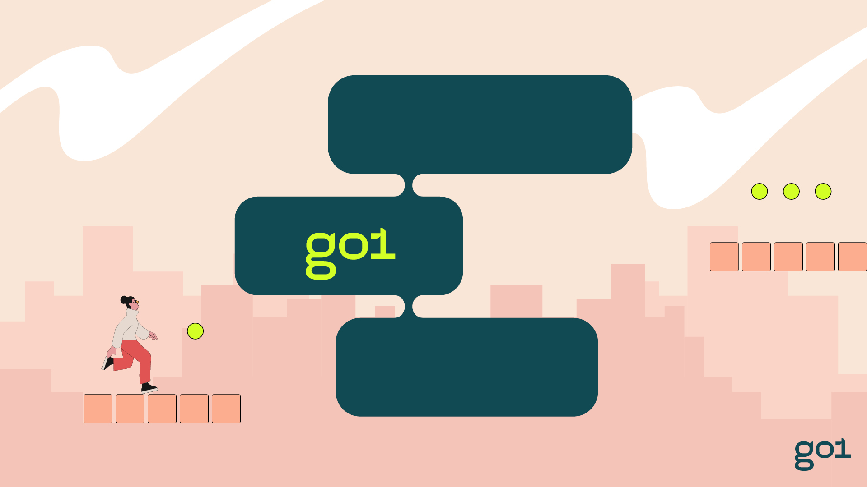
Ready, set
Get ready to dive into your new ecosystem of personalised digital learning, curated to take your team
to the next level.

Slide 2

What’s in it for you and your team?
Go1 gives you instant access to more than 80,000 learning resources from the world’s best content providers.
Sourced, aggregated, and curated
to help you stay compliant and at
the top of your game.

Slide 3
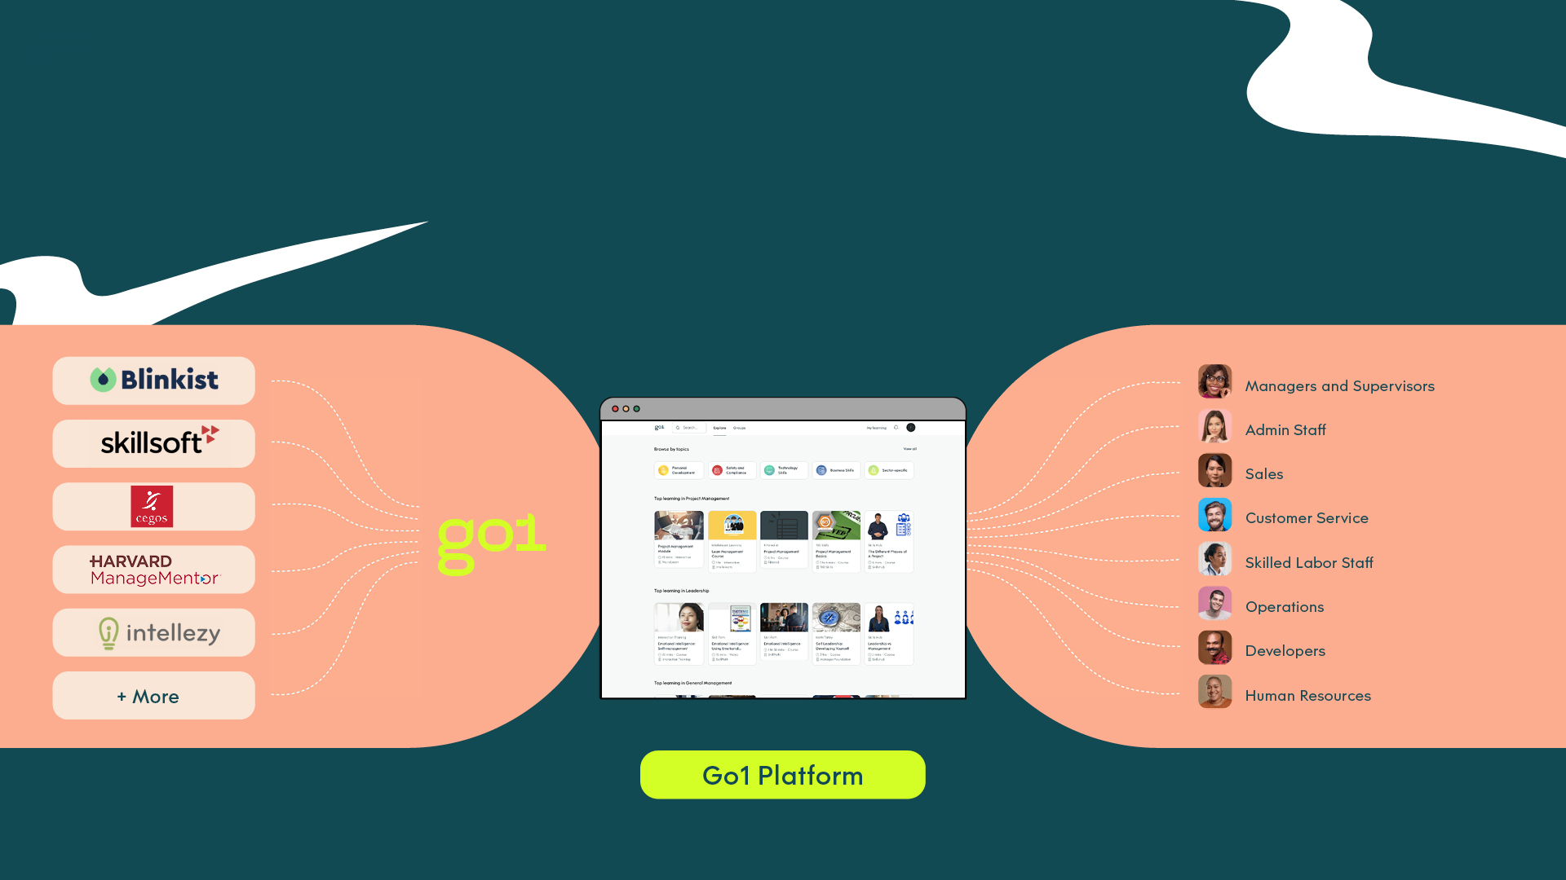
Keep your team ahead of the game with quality learning content for every role, at every level
A solution aligned to your team’s needs.
Where you learn

Slide 4
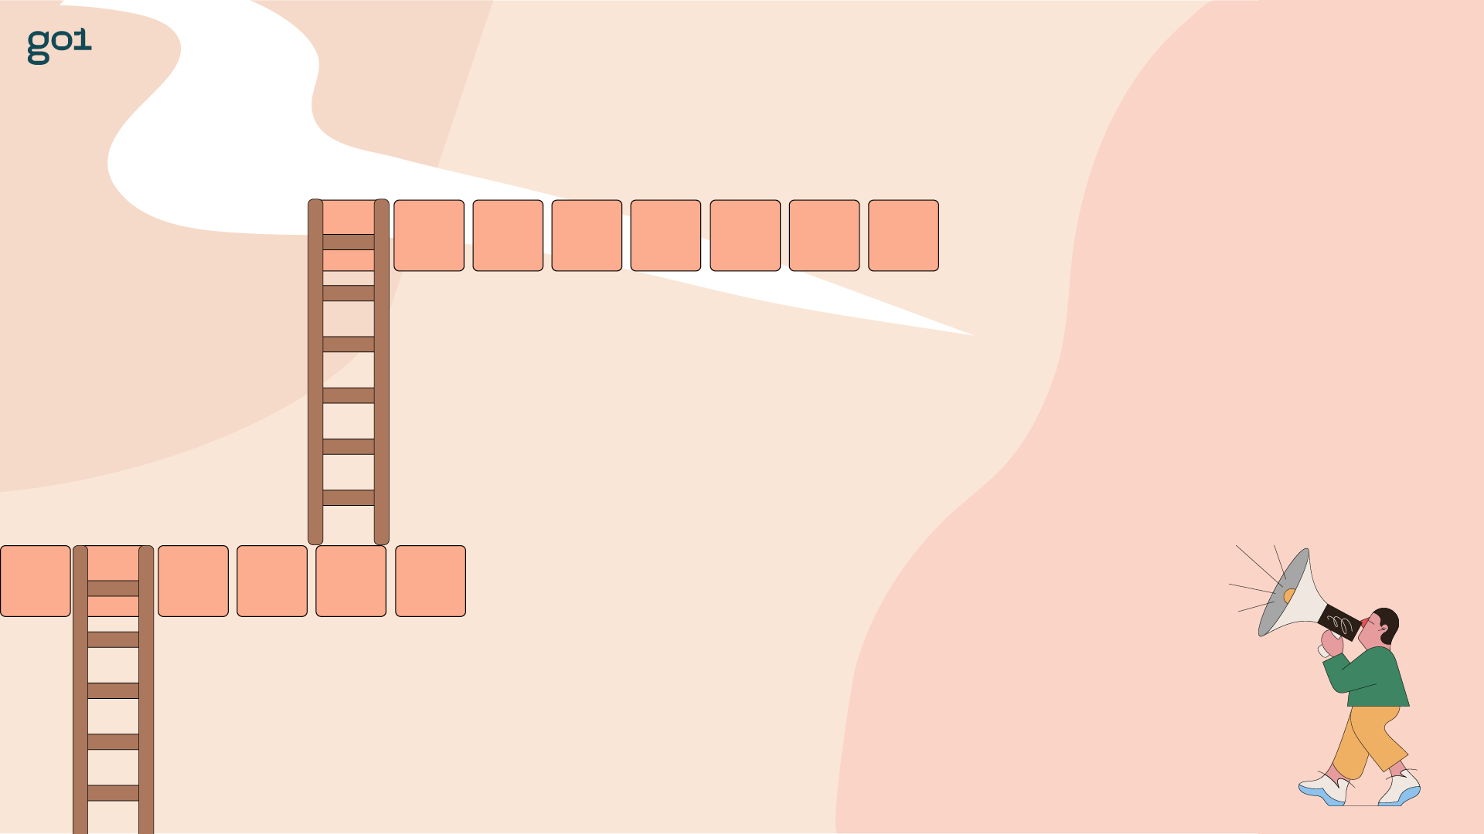
Go1 learners are proven to jump higher and grow faster
Consistent and relevant learning is a catalyst for career, and organizational success.
Where will Go1 learning take you and your team? The possibilities are endless.

Slide 5
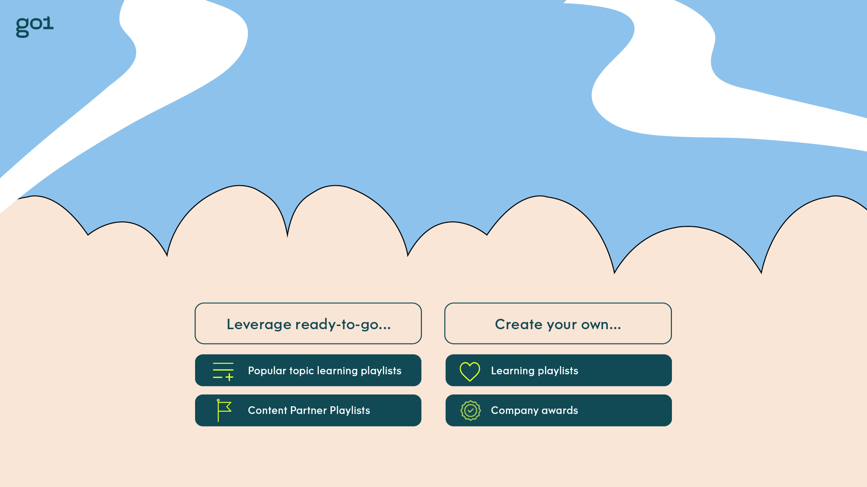
Ready to level up?
Once you’ve registered, log in to your team’s LMS or via the Go1 portal for instant access.

Slide 6
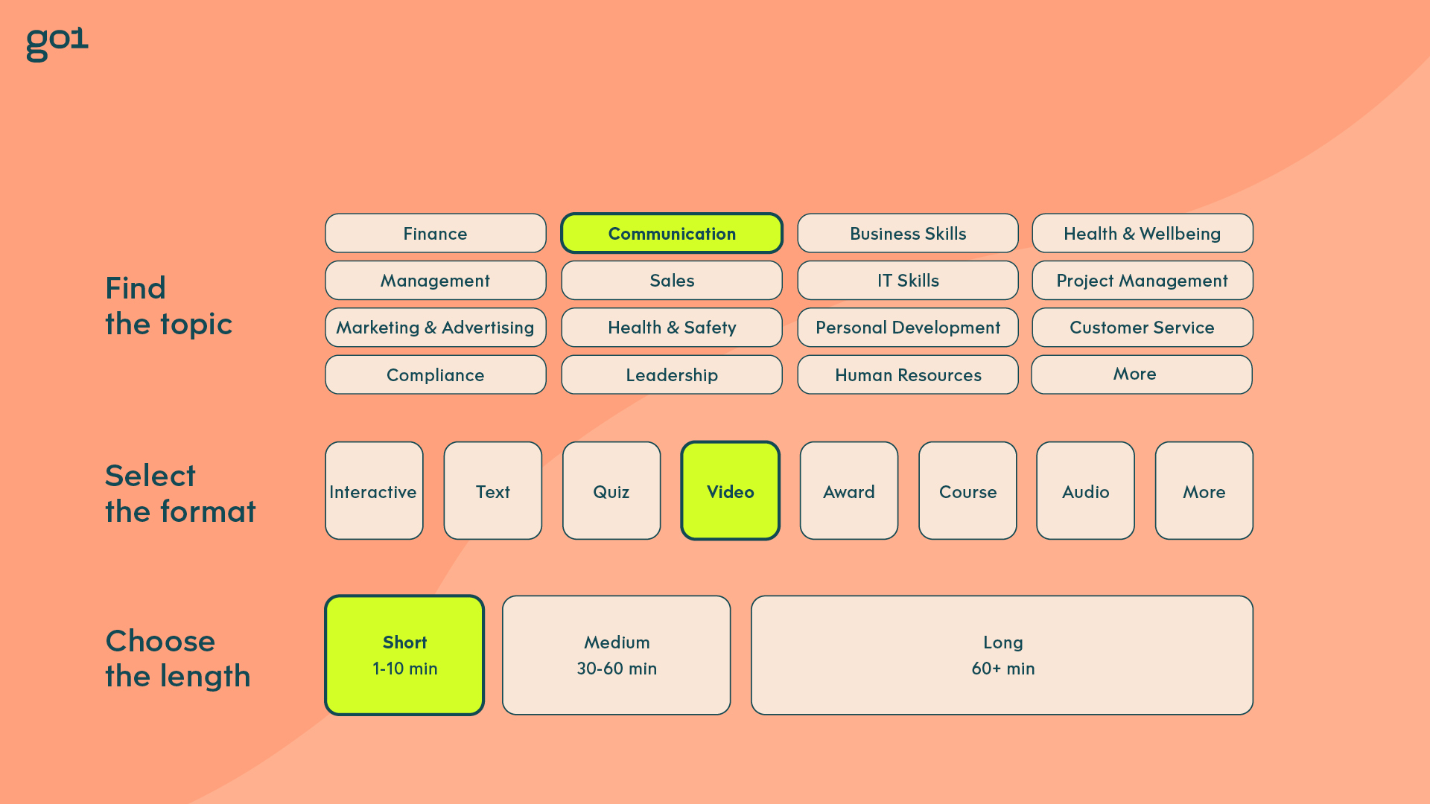
Fulfil the needs and skill gaps of every learner

Slide 7

Your team can own their wins and targets with Awards
Create targets to ensure completion
of all components
Set learner expectations by setting
due dates
Add previously completed external records
Add your own-created content alongside Go1 courses

Slide 8

Tracking your team’s learning journey has never been easier
Save time and effectively manage your team’s learning journey easily in one convenient place.
Easy Learning and Reporting
Centrally track progress and completion data
Configure reports to meet your needs
Always report in real-time
Simple to share with everyone inside (and outside) the Go1 platform
Re-assign learning to users in
one click
Single Sign-On (SSO)
Strengthened security
Improved usability for all employees
Seamless user access between systems
One Way Data-Feed
Streamline employee onboarding
User data integrity across systems
Regularly refreshed to reflect changes to data

Slide 9
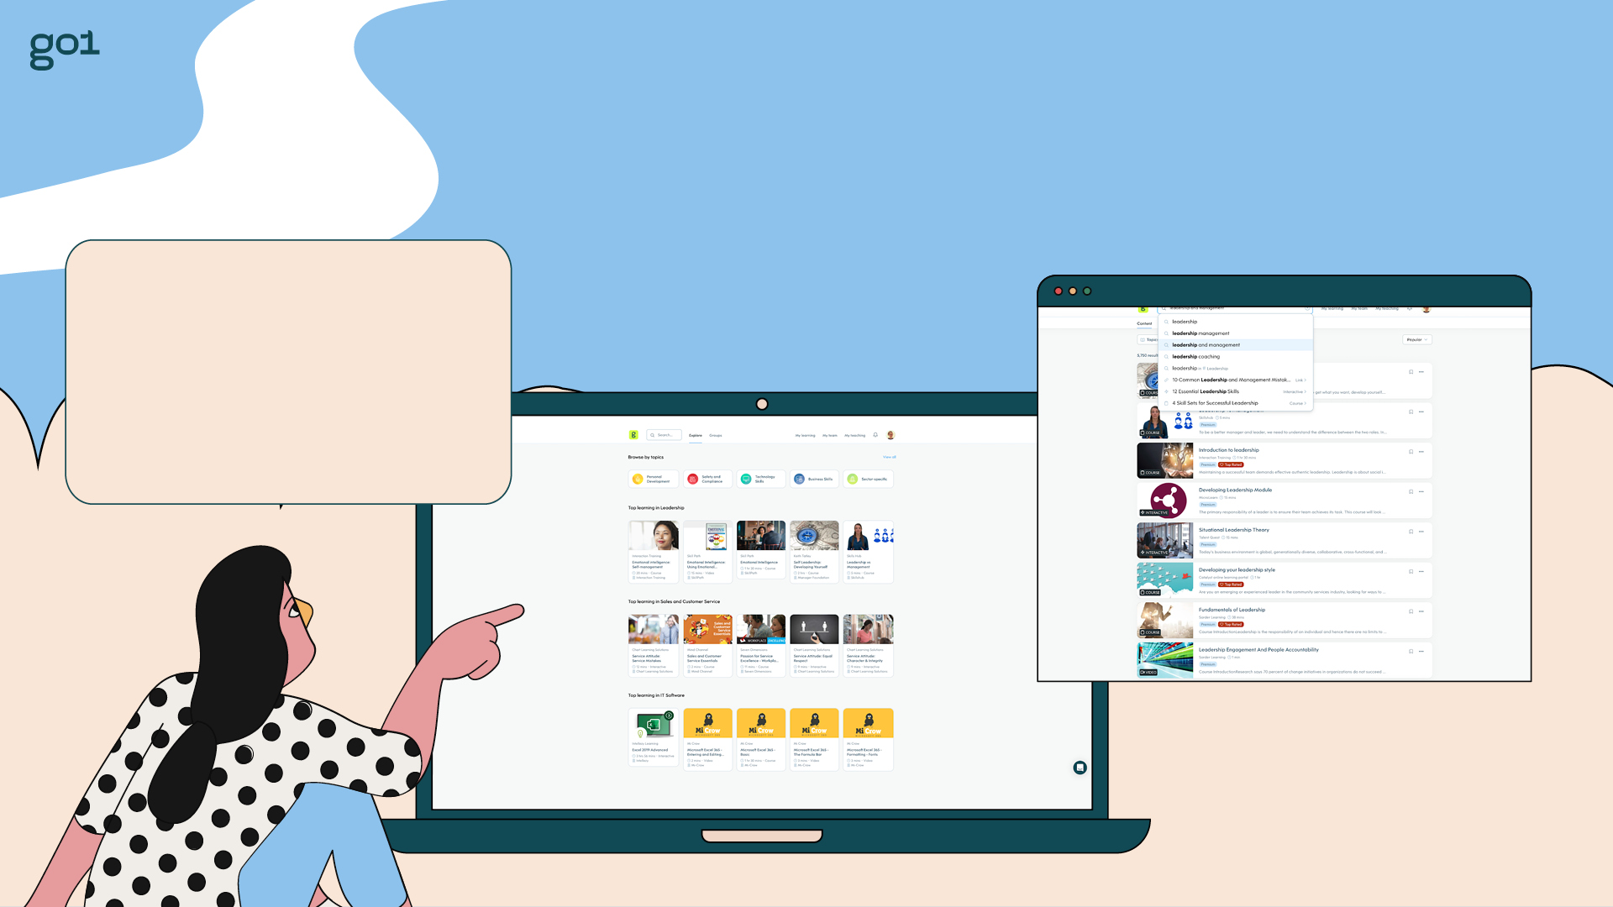
Contextual learning at your fingertips with our course creation tool
Find high quality, relevant courses. Save courses for later. Personalise your recommendations.
Create organization-specific learning
Support blended learning via Events
Test knowledge with in-build assessment tool
Test knowledge with in-built assessment tool

Slide 10
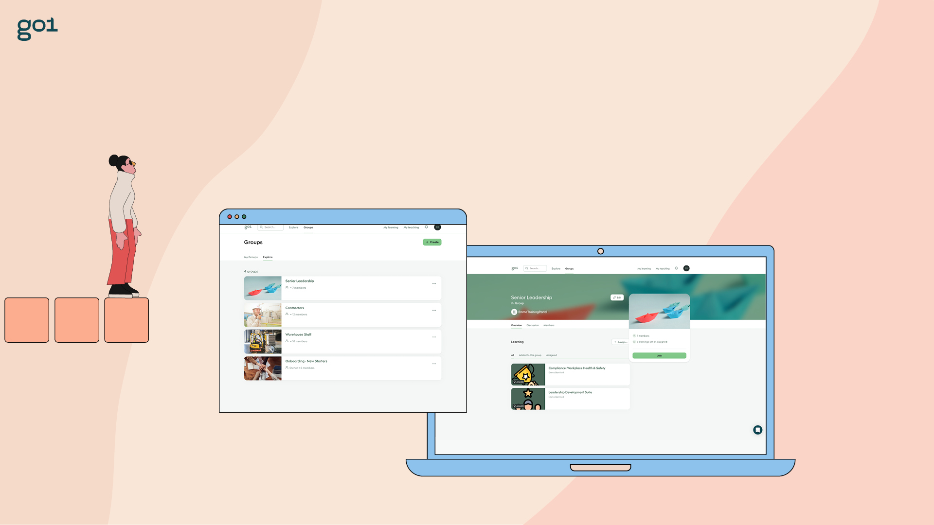
Learn and grow as a team
Access discussion groups for common topics and team members.

Slide 11

Go1 with the flow
Discover and launch learning directly within Teams
Collaboratively build learning pathways
A familiar experience for users
Learn together in a virtual classroom
Consistent learning records

Slide 12

A little learning goes a long way
You don’t need to spend 10,000 hours
to start growing. Most learners see a marked improvement in as little as 2 hours per week.
Track your progress and share your achievements with the team. Now that’s worth celebrating!

Slide 13
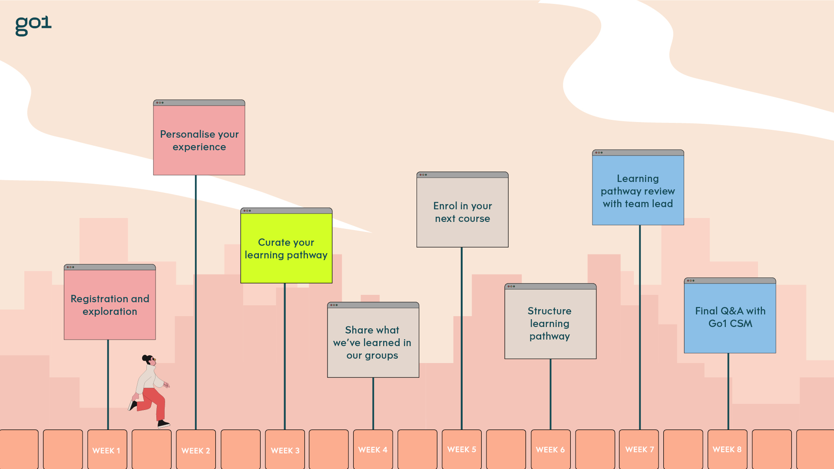
Our path to unlock your potential

Slide 14

Win the
learning
game!

